Slide 1
TABLEAU PROJECT
AmAzon prime Video : movie and TV shows Data analysis

Slide 2
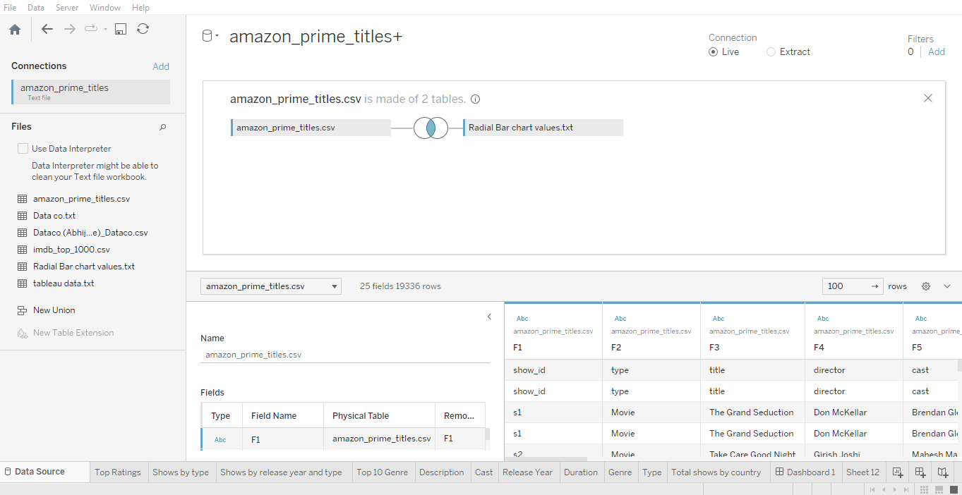
Title is made up of two Tables : Join Calculation 1 on both Joins

Slide 3
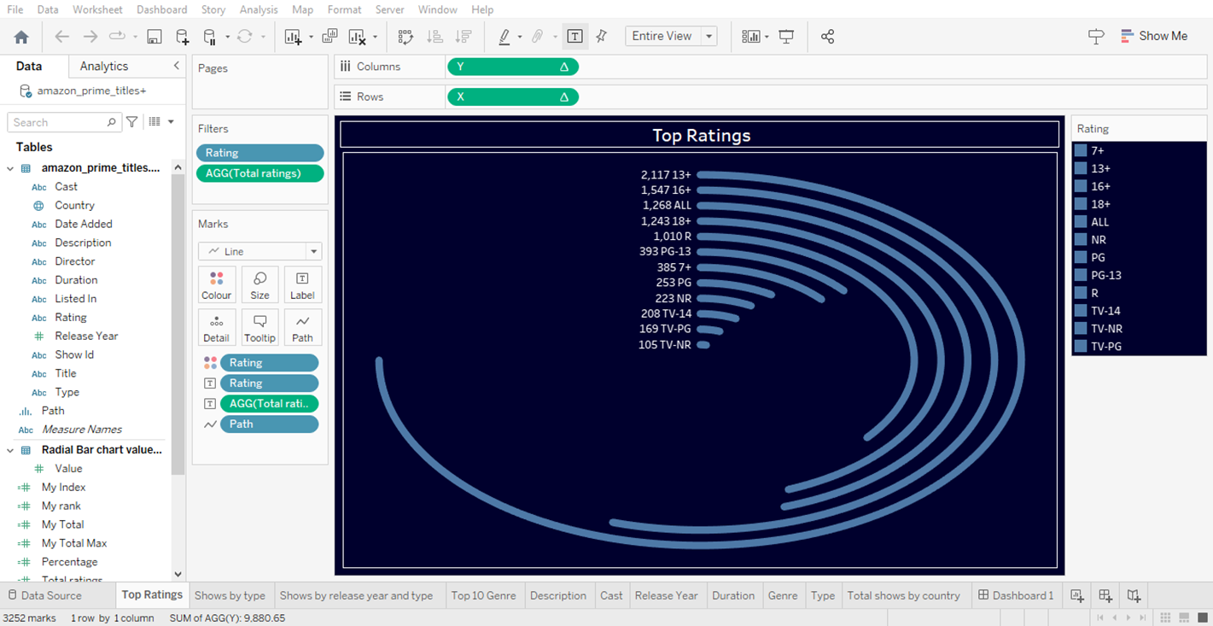
Calculations for Radial Bar Chart :
Top Rating : COUNTD([Title]) 2. Percentage : [My Total]/[My Total Max]
3. My total max : WINDOW_MAX([Total ratings])
4. My total : WINDOW_MAX([Total ratings])
5. My rank : RANK_UNIQUE([My Total], 'asc') 6. My Index : INDEX()-1
7. X: COS(RADIANS([My Index]*[Percentage]))*[My rank] 8. Y : SIN(RADIANS([My Index]*[Percentage]))*[My rank]

Slide 4
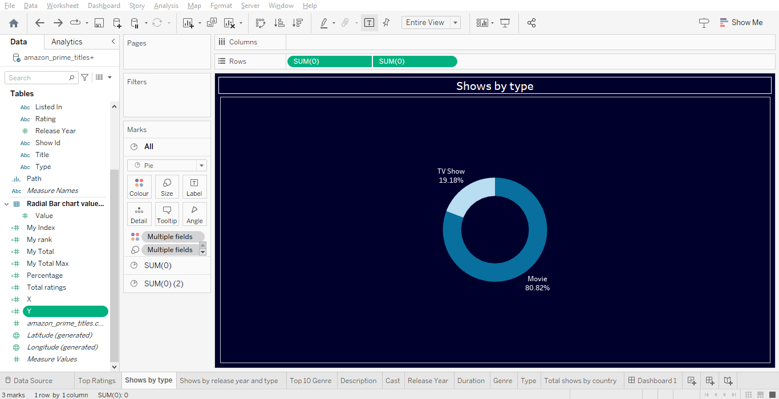
Show by Type : Pie charted created by using dual axis
Use two pie charts
Add a measure as a dual axis
Select Pie from the drop-down menu in the Marks card, and drag Measure Values to Size and Measure Names to Color
Create a dual-axis map by using Tableau Latitude (generated) and Longitude (generated) fields, custom latitude and longitude fields, or a combination of both
Right-click the second calculated field Axis Adjustment and select Dual Axis, then uncheck Show Header for each of the axes.

Slide 5
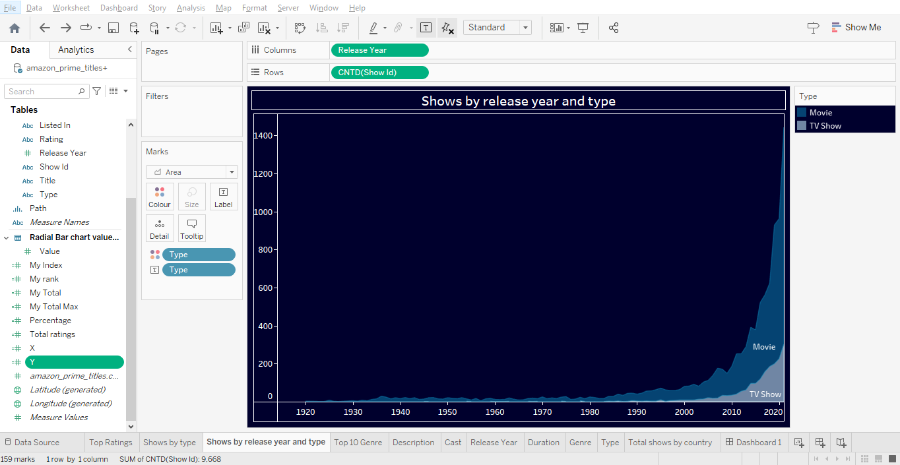
Shows by release year and type :
Area Chart Analysis

Slide 6
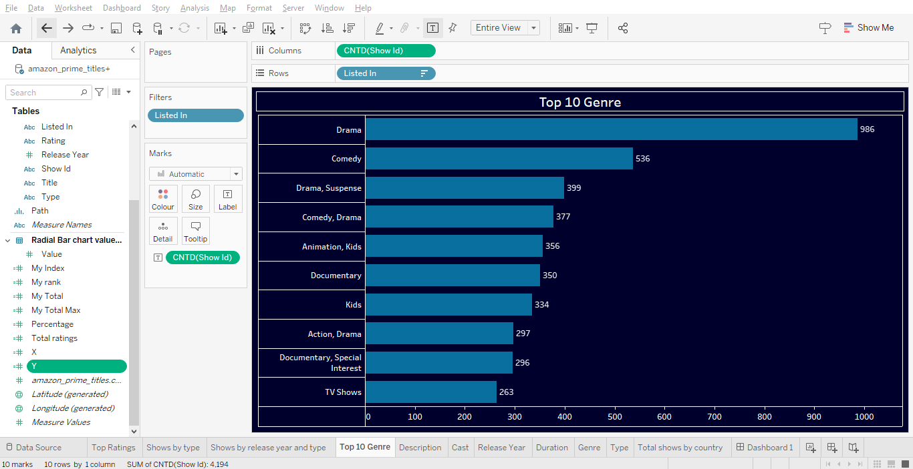
Top 10 Genre : Bar Chart analysis

Slide 7
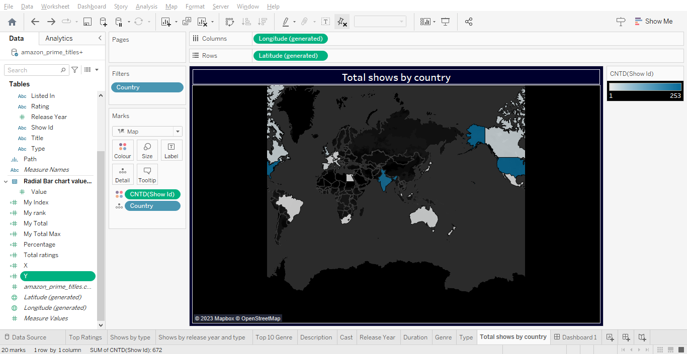
Create Map :
Click On Country>Go to Map option from above bars>click on Background map>Dark Colour>Then apply data as per record.

Slide 8
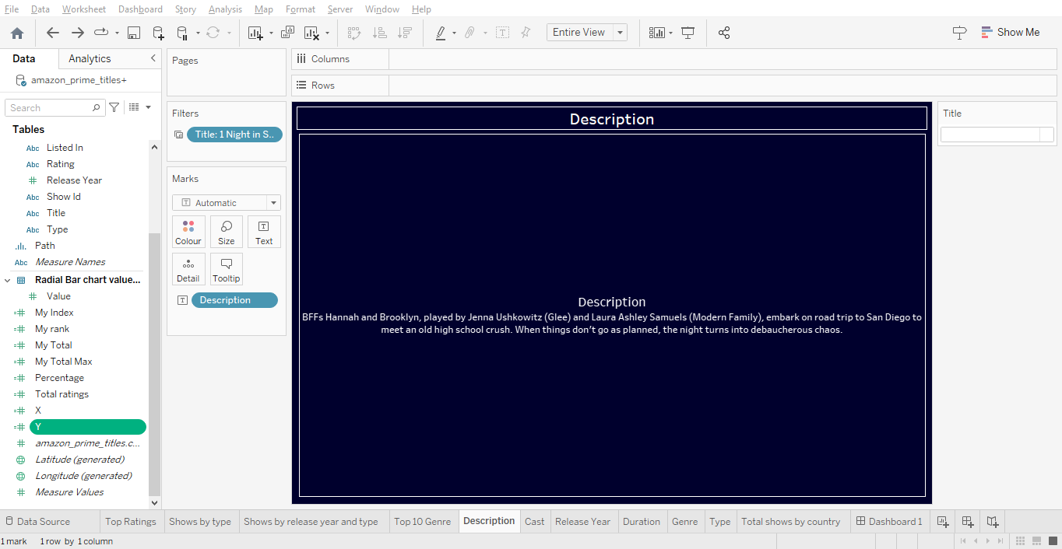
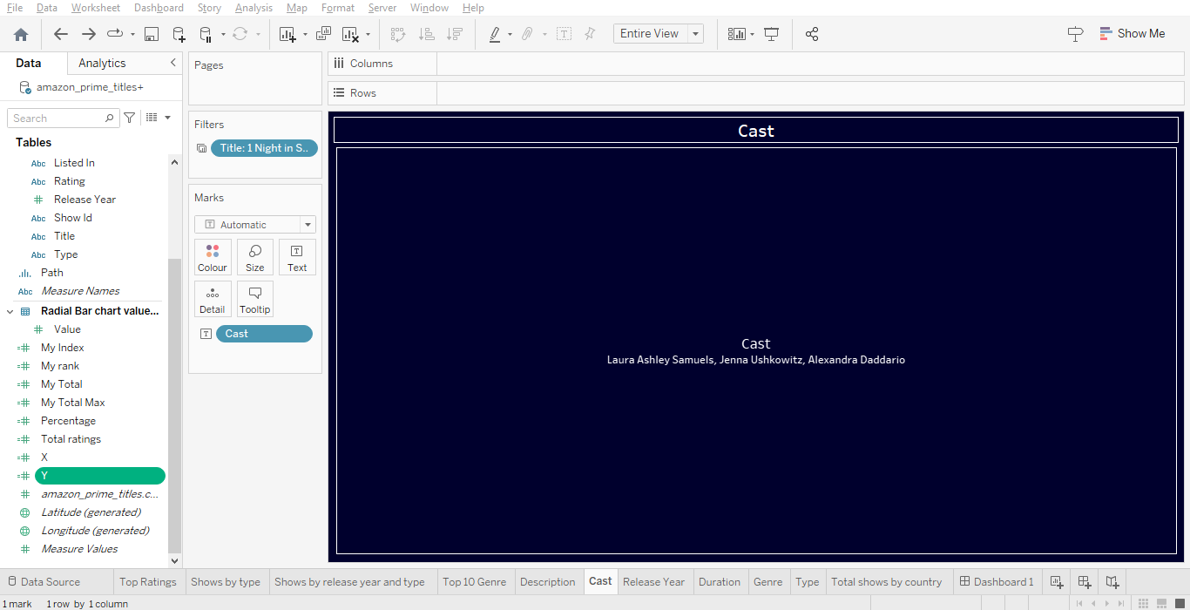
Created Text Sheet :

Slide 9
DASHBOARD IMAGE

Slide 10
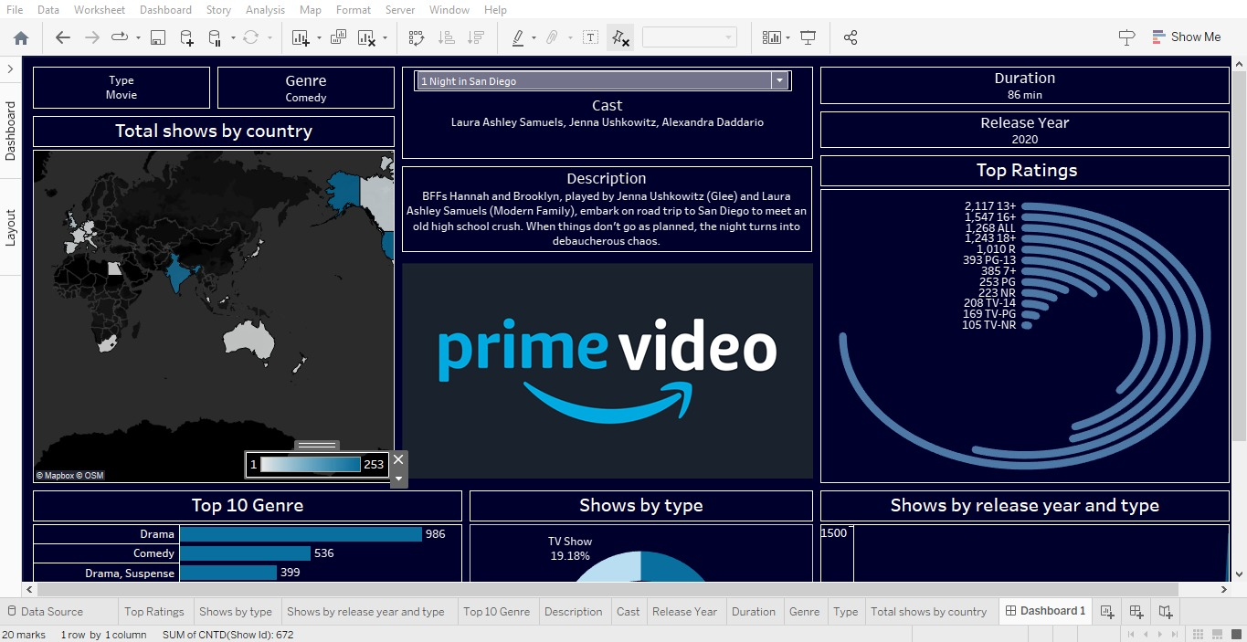

Slide 11
